Slide 1
Optimizing Ski Resort Ticket Prices Using Predictive Modeling
Big Mountain Case Study
Maria Suarez
04/17/2025

Slide 2
Business Problem:Is Big Mountain Underpricing Its Tickets?
Data-driven approach to optimize pricing decisions.
Current ticket pricing may not reflect the value of the resort’s features.
Predict fair ticket prices using resort features and test various upgrade scenarios.

Slide 3
What did we use ? Dataset: U.S ski resort features + ticket prices
Key Features:
Key Features:
Key Features:
Key Features:
Vertical Drop
Number of runs
Lift types and counts
Snowmaking area
Target Variable :
Adult Weekend Ticket Price

Slide 4
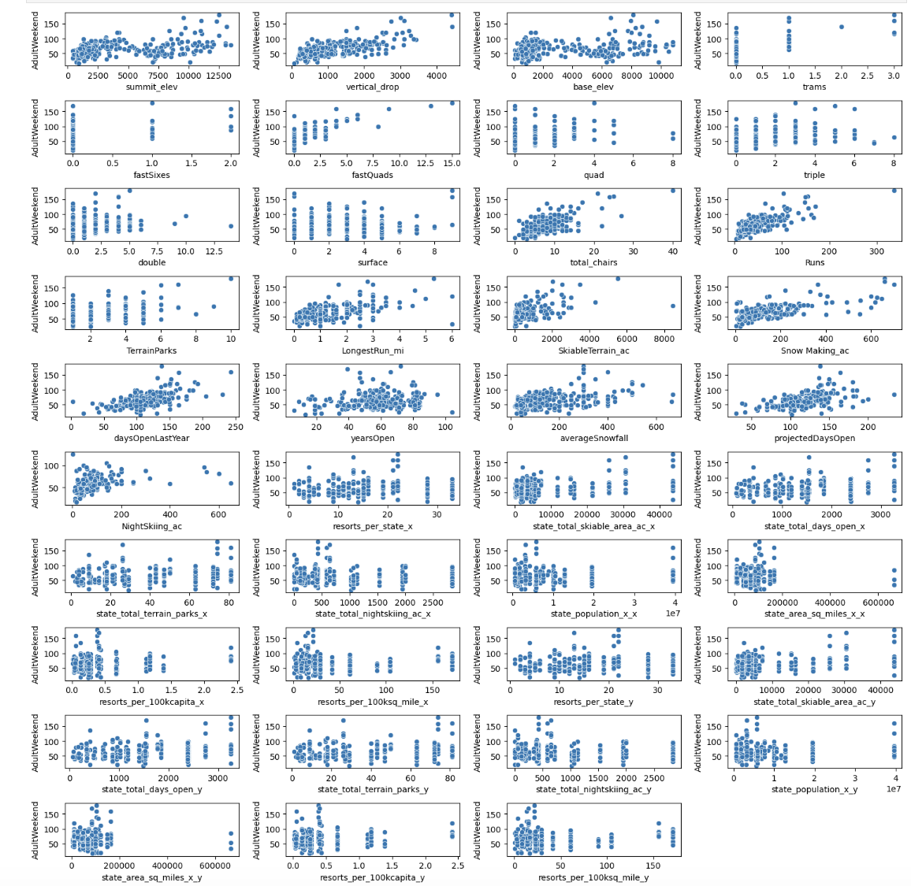
Strong Positive Relationships
Vertical Drop: Higher vertical drop is clearly associated with higher ticket prices.
Total Chairs and Runs: Resorts with more lifts and runs charge more.
SkiableTerrain_ac: Larger skiable area generally leads to higher prices.
Snow Making_ac: More snowmaking capacity correlates with increased pricing.

Slide 5
Big Mountain Is Likely Undervalued
Total chairlifts
Top Price Drivers
FastQuads
Vertical Drop

Slide 6
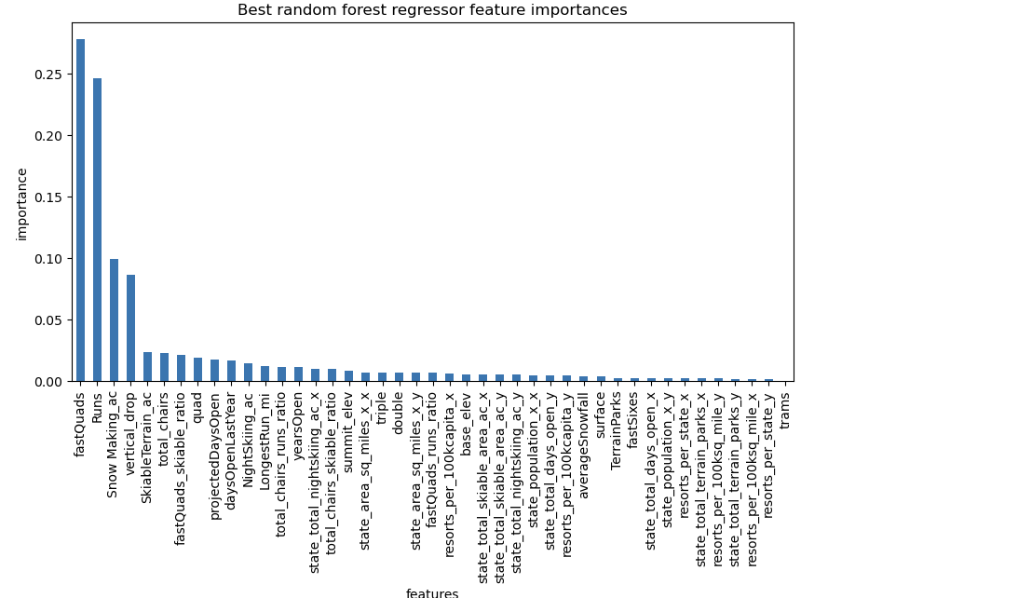
Recommendation: Increase ticket price to better reflect facility value and use the model to guide strategic upgrades.

Slide 7
How We Built the Model
Tools
Python (pandas, sklearn), matplotlib
03
Models Used
Baseline (mean) Linear Regression Random Forest Regression
01
02
Evaluation Metrics
R² MAE MSE

Slide 8
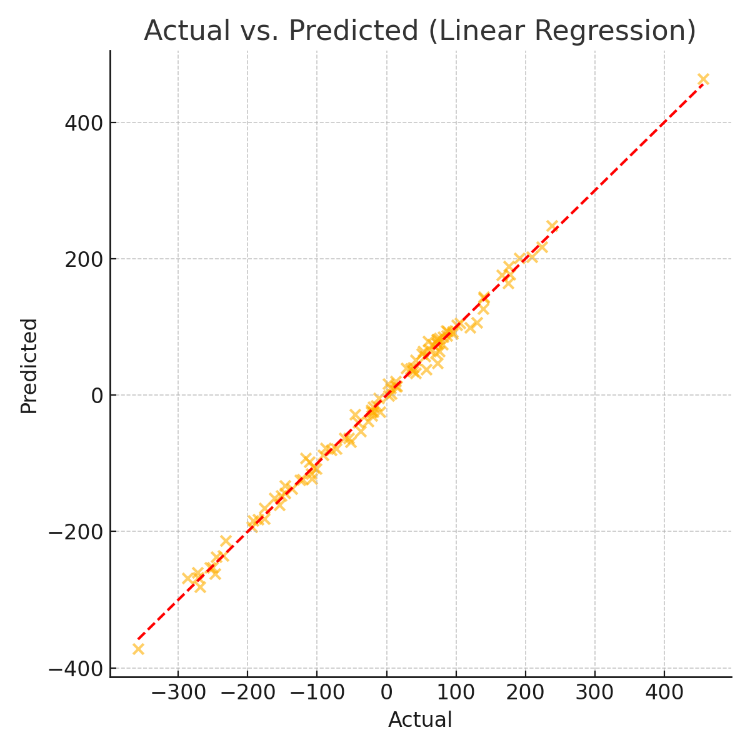
Actual vs.Predicted Prices
Random Forest outperforms Linear Regression
Strong alignment between predicted and actual prices
Minimal overfitting observed

Slide 9
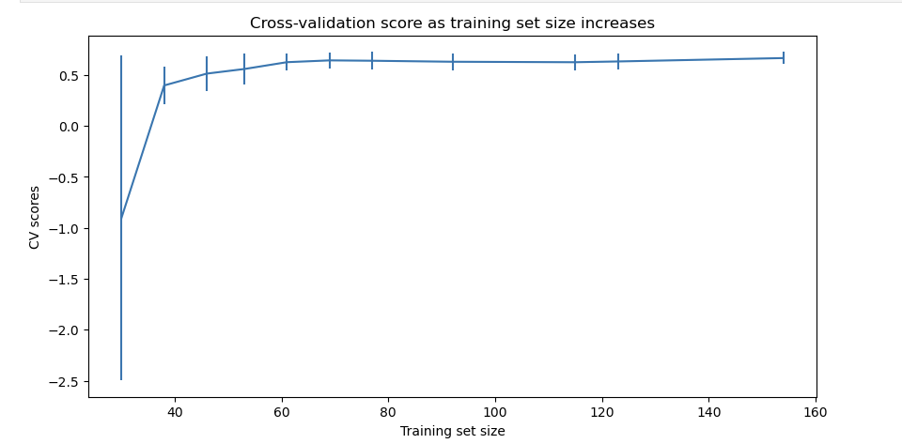
How Good Was the Fit?
Residuals show mostly random distribution (no major bias)
Learning curve indicates solid generalization with current data
Cross-validation confirms model stability

Slide 10
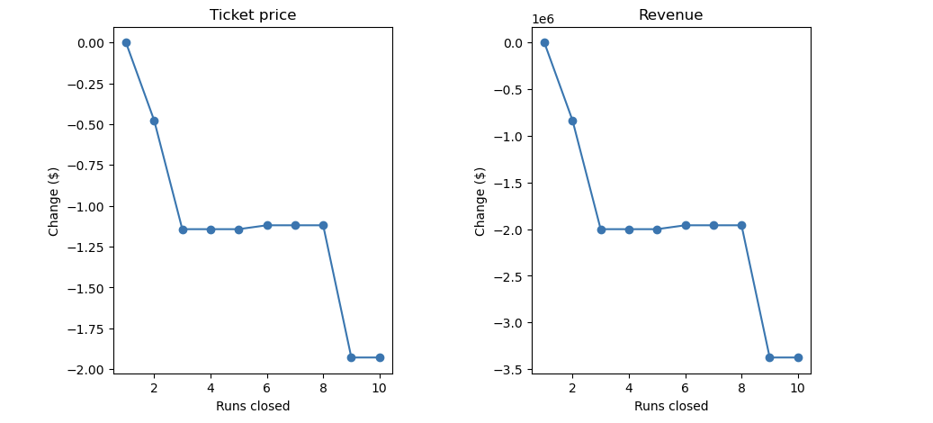
What if we upgrade the resort ?
Scenario 1: Add chairlift and run → Moderate price lift
The model says closing one run makes no difference.
Closing 2 and 3 successively reduces support for ticket price and so revenue.
If Big Mountain closes down 3 runs, it seems they may as well close down 4 or 5 as there's no further loss in ticket price.
Increasing the closures down to 6 or more leads to a large drop.

Slide 11
What if we upgrade the resort ?
Scenario 2: Add vertical drop → High impact
Scenario 3: Add 2 acres of snowmaking → Negligible effect

Slide 12
Wrap-Up
Big Mountain may be underpriced compared to similar resorts.
Data shows clear ROI on high-impact upgrades (lifts, terrain).Could justify a price increase of more than $8, covering the lift’s cost while boosting profit
Recommend building a dashboard or tool for business analysts to explore price scenarios independently.
Next: Add cost and visitor volume data for full profitability modeling.

